Slide 1
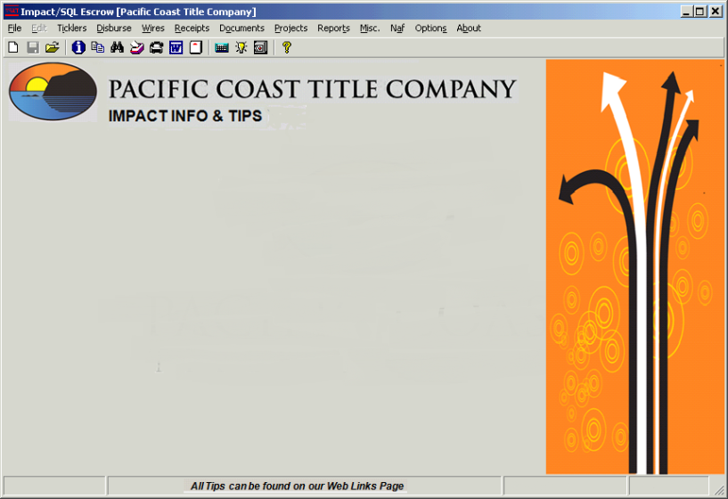


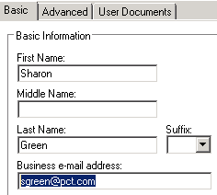
smartVIEW TIPS
4/21/14
Update Your smartVIEW Email Address!
Click “My Profile” Tab
Change to
@pct.com

Slide 2

smartVIEW Info & Tips
9/20/2013
smartLINK Icon Not Working?
Try This New Link!!!
https://www.smartviewonline.net/
Copy the link above and paste it into
your Internet Explorer address bar
When you’re able to connect to smartLINK
(smartVIEW Online) and login please call
Sharon Green or Jose Hill and they will
repair your Desktop icon so it works properly.

Slide 3
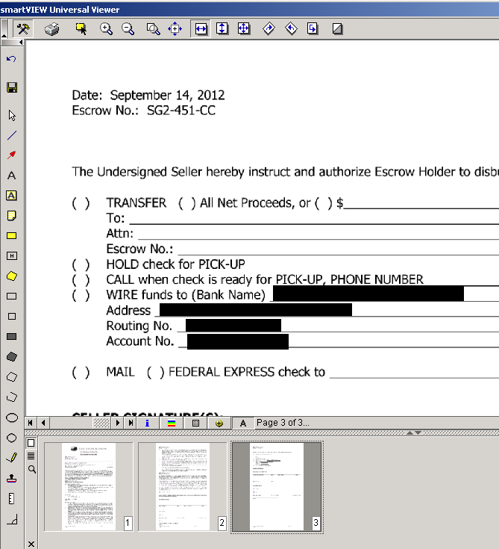
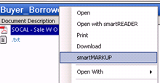
smartVIEW Info & Tips
7/25/2013
smartVIEW Info & Tips
View the Document in Bottom SV Viewer
Right Click On the Document
Select smartMARKUP
Let Document Build
Press “Draw Redaction” button
Draw Black Out of Sensitive Information
(i.e. Buyers Deposit Acct Info, Seller’s Wire Info)
Click Print Icon > smartPRINT to file
REDACTION WITH smartMARKUP
Call Sharon Green for Training
479-427-6114
No Need to Print Your Prelim!
Write on Them With smartMARKUP!
Lots of Ready-Made Stamps
Add ALL of Your Notes Electronically!
Call Sharon for More Info
DocuSign Coming Soon! Electronic Signing!

Slide 4
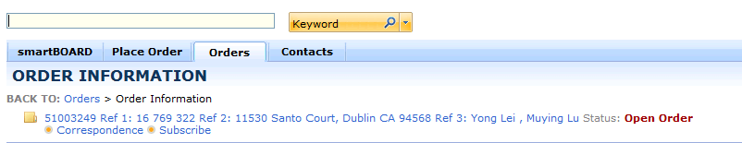
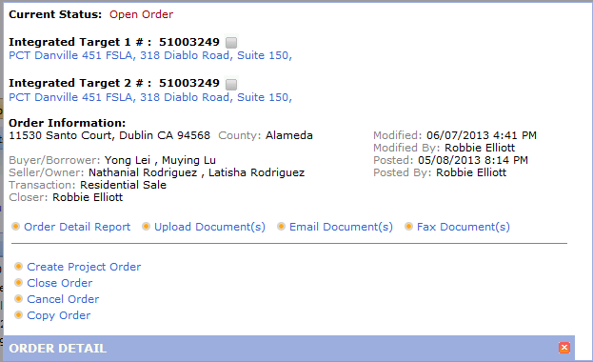
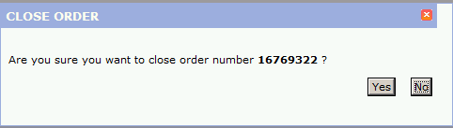
smartVIEW Info & Tips
6/11/2013
ALWAYS CLOSE YOUR ORDERS
IN smartVIEW Online (smartLINK)
#1 Click
Open
Order
Order # / Enter
Nocal
Use Your smartVIEW Checklist!!
Verify File Closed / Docs Uploaded
Scan Checklist into smartVIEW
smartVIEW # shows here
#3 Click Yes
#2 Click
Close Order
Please Call if You Need Help!
Sharon / 479-427-6114

Slide 5
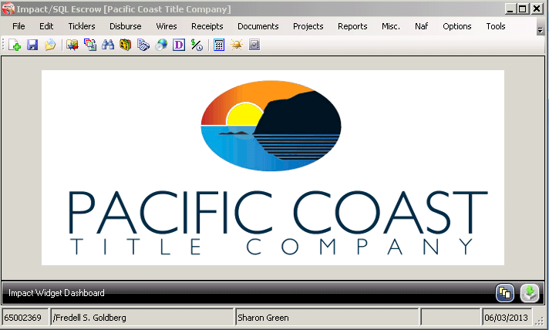
smartVIEW Info & Tips
6/03/2013
Auto Publish to smartVIEW by SAVING
Out Of Your New Impact Order
Save
Press The “Save”
Button to Save The Order
So Your File Will Publish

Slide 6
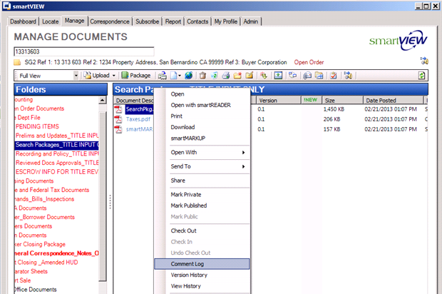
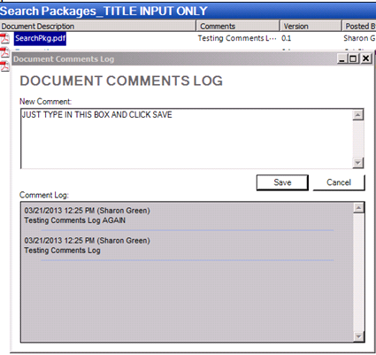
smartVIEW Info & Tips
6/24/2013
SMARTVIEW COMMENTS LOG!
Right Click On Document
Select “Comment Log”
Type Text Here & Press “Save”
Comments Saved Here!!

Slide 7
smartVIEW Info & Tips
5/20/2013 Impact v8.0
EXCITING CHANGES FOR IMPACT/SMARTVIEW
DSI is Giving PCT an Improved Interface Between
Impact and smartVIEW TONIGHT!
(You Do NOT Have To Be Out of Impact During This Change)
Beginning Tomorrow Morning!:
When you’re finished opening an order and save out of your file, Impact will automatically publish it to smartVIEW within 2 minutes
Your changes in Initial Questions will automatically publish to smartVIEW
You still must publish your Order Sheet to smartVIEW
Nocal

Slide 8
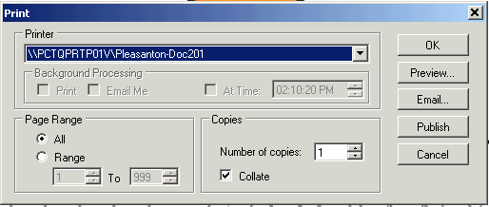

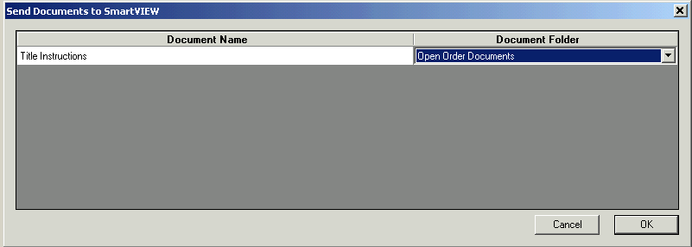
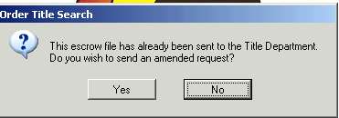
smartVIEW Info & Tips
4/09/2013
Nocal
PUBLISH YOUR ORDER SHEETS TO SMARTVIEW
* Documents
* Title Instructions
* Publish Button
Click the No Button
Use the Drop Down Menu to Publish to
Open Order Documents

